Slide 1
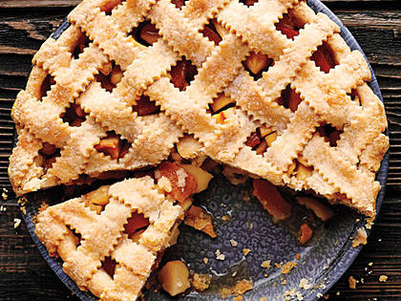
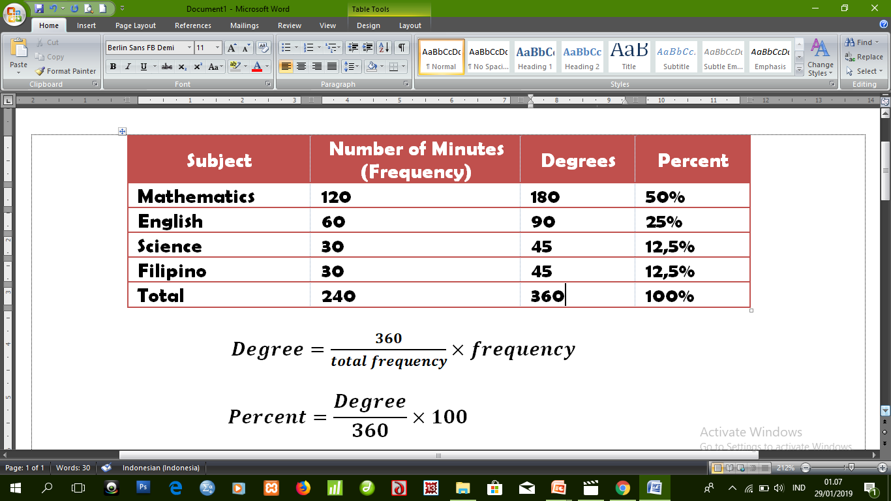
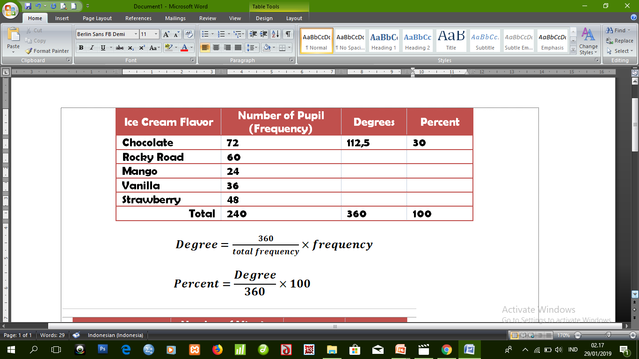
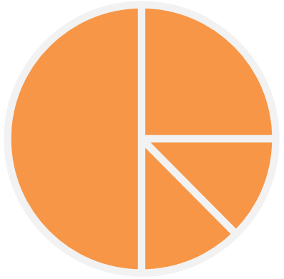
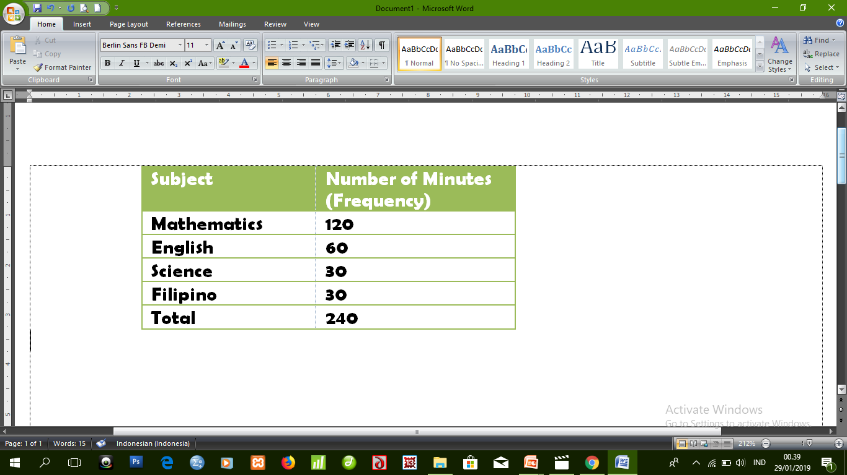
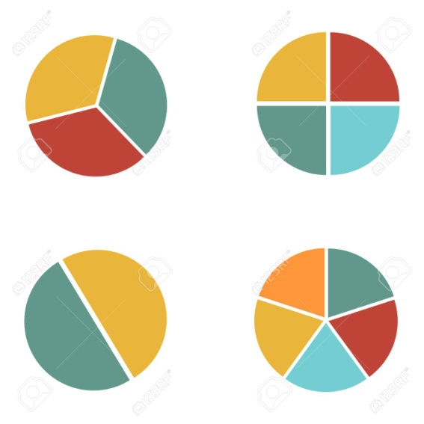
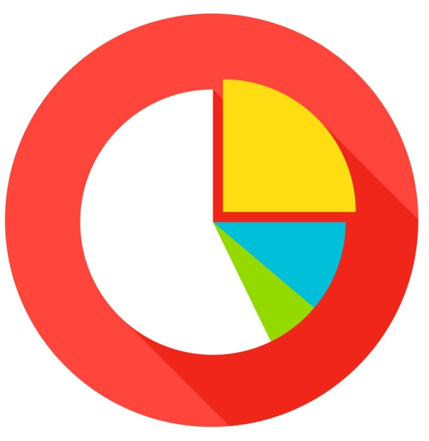
EXAMPLE
Justin loves mathematics very much so he spent more time studying his lesson in mathematics during weekends.
Below is the schedule of his study.
To represent the data in the pie graph, use a protractor.
PIE GRAPH
E
STATISTIC IS FUN
CARRY OUT
A pie graph or a circle graph is devided into parts to show relative size of each value.
D
ENGLISH
To draw a pie graph, we need to represent each part as a proportion of 360 because a circle has 360 degrees
C
MATHEMATICS
SCIENCE
Protractor is an instrument used to determine the degrees represented by each data in a pie graph.
Remeber, a pie graph is also called a circle graph and a circle has 360 degrees.
FILIPINO
B
To represent the amount of time each subject is represented in the pie graph in terms of the number of degrees, follow the formula.
Let’s draw the pie graph now
A

